Slide 1
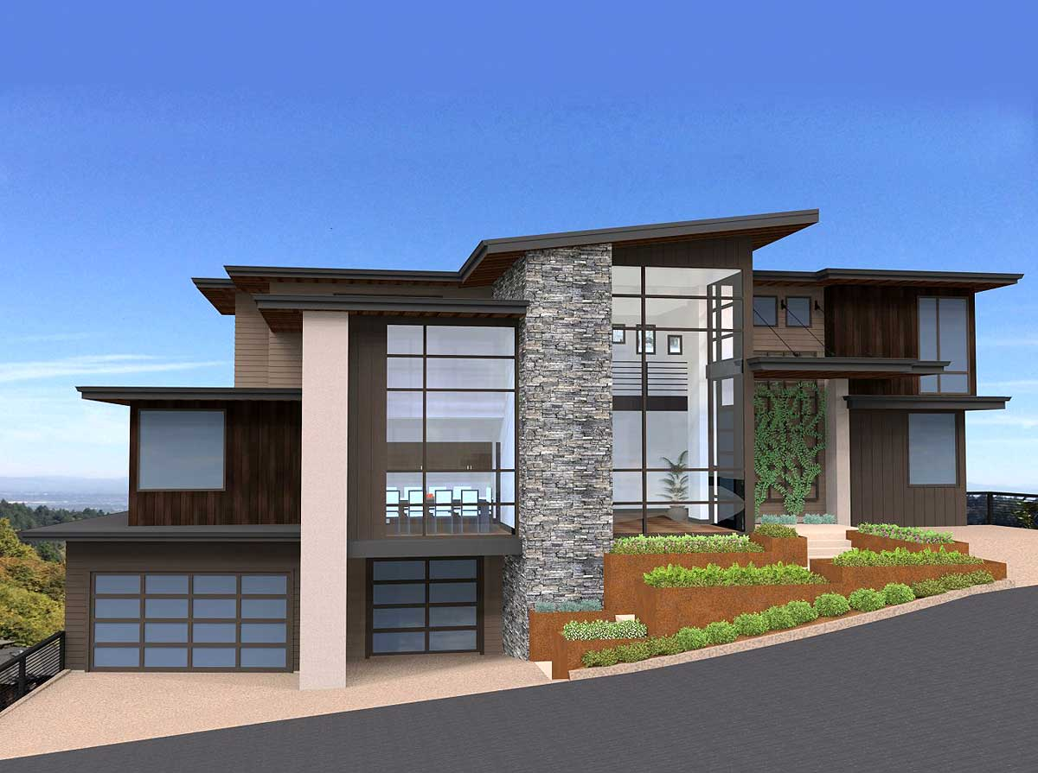
BLOC HOME
Smart Real Estate Contracts w/ A Push Button

Slide 2
Contents
Team 1- Dealerless Deals
Project Description
Property Management Process
Development platforms
Financial Transaction Management Solution
Demonstration(s)
Challenges
Next Steps

Slide 3
TEAM 1
Dealer Less Deals:
Kowsalya Jeyabalan
Maitree Maniar
Cody Sifford
Nate Walker

Slide 4

Project Description

Slide 5
Project – 3: Description
Develop a digital real estate blockchain platform for the management of luxury home, apartments, investment property, property rentals, and sales.
Utilize Digital Token Technology to manage the distribution of real estate smart contacts.
Utilize computer algorithms, blockchain, location data, predictive analytics and more to help investors locate and sell properties, find renters and maximize their real estate investments.

Slide 6
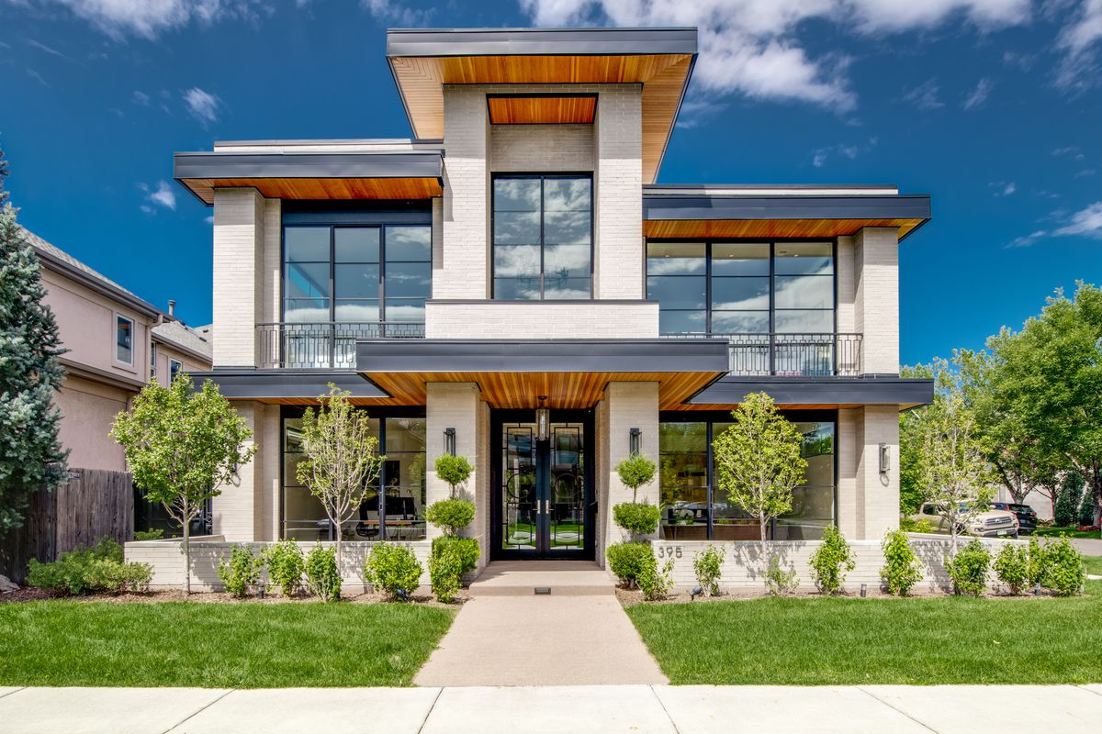
PROPERTY MANAGEMENT Process

Slide 7
Property management Process Details
Online Web Portal
Property listing management
Auctions
Token Management
Smart Contracts:
Lease / Rental
Owner Tenants / Seller / Buyer
Security Deposit

Slide 8

Development platforms

Slide 9
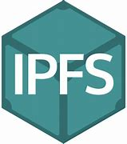







DEVELOPMENT PLATFORMs
Notes:
The development platform- back-end interface includes:
InterPlanetary File System (IPFS) is a protocol and peer-to-peer network for storing and sharing data in a distributed file system. IPFS uses content-addressing to uniquely identify each file in a global namespace connecting all computing devices.
IPFS is talking to metamask, ganache, remix, and running solidity, python (Web3.py) , and github pages for the front-end interfacing.
MetaMask - is a browser plugin that allows users to make Ethereum transactions through regular websites. It facilitates the adoption of Ethereum because it bridges the gap between the user interfaces for Ethereum
Web3.py helps you access your Ethereum node from Python.
Making all of this possible is the InterPlanetary File System (IPFS), A communication Protocol.

Slide 10

Financial transaction management

Slide 11
Financial transaction management
Blockchain Technology
Digital Tokens
Digital Wallet
Gas
Smart Contracts

Slide 12
FTMS – BLOCKCHAIN TECHNOLOGY
Blockchain technology has been adopted and adapted for use by the commercial real estate (CRE) industry.
CRE executives are finding that blockchain-based smart contracts can play a much larger role in their industry.
Transform core CRE operations such as property transactions like purchase, sale, financing, leasing, and management transactions.

Slide 13
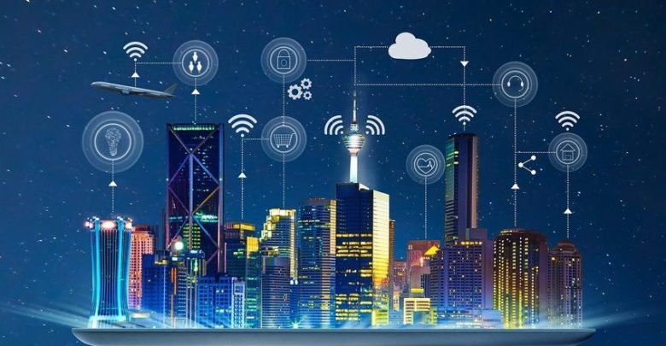
FTMS – DIGITIAL TOKENS
Non-Fungible Tokens:
ER C721 Standard
EIP 2615 Standard
Smart Contracts
Mortgage Functions
Rental Functions

Slide 14

FTMS – DIGITIAL wallet
It’s a so-called digital wallet that runs as a Chrome extension. It stores Ethereum assets and shows transactions.
Software that manages your private keys and converts it to blockchain address format.

Slide 15
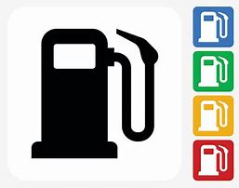
FTMS – Gas
Is what incentivizes nodes for participating in the network and computing jobs to deploy smart contracts into the database
Is used when a user makes a smart contract function call, they must declare the amount of gas and pay that amount
Motivates miners to compute jobs
Motivates developers to deploy efficient code to optimize the use of deployed protocols

Slide 16
FTMS – SMART CONTRACTS
A Computerized transaction protocol that executes the terms of a contract
Ethereum allows developers to write smart contracts which define the EVM* instructions
Smart contracts exist within the decentralized database
* Ethereum Virtual Machine, Decentralized database – allows functional code to be distributed along the decentralized set of nodes.

Slide 17
Housing modeling analysis
Ames, Iowa Housing Sales
Regression Analysis
Deep Learning
Model Selection

Slide 18
Ames, Iowa Assessor’s home sales (2006 -to - 2010)
Data Dictionary Highlights:
2930 Rows
82 columns which include 23 nominal, 23 ordinal, 14 discrete, and 20 continuous variables
Nominal Variables : Identifies the type of dwelling involved in the sale and zoning classification
Ordinal: General shape of property and type of utilities
Discrete: Original construction dates
Continuous: Masonry veneer area in square feet

Slide 19
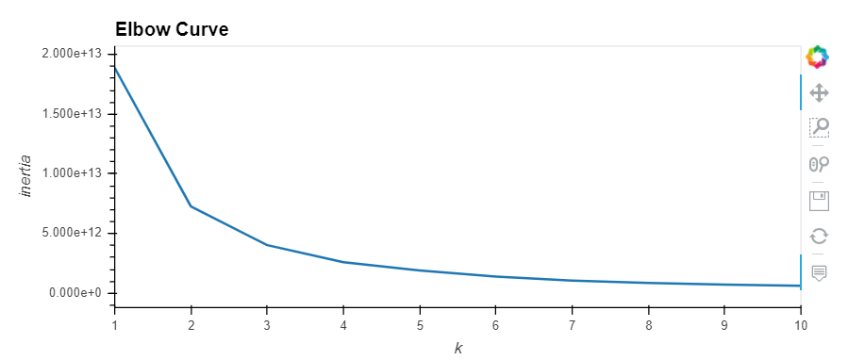
Ames Housing Data: cluster analysis
K = Number of Clusters in the dataset.
K = 7

Slide 20
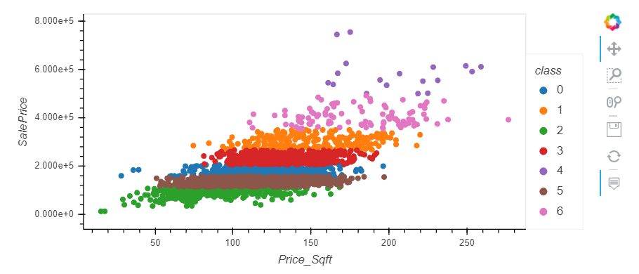
Ames Housing Data: sales price by Price/sqft by cluster

Slide 21
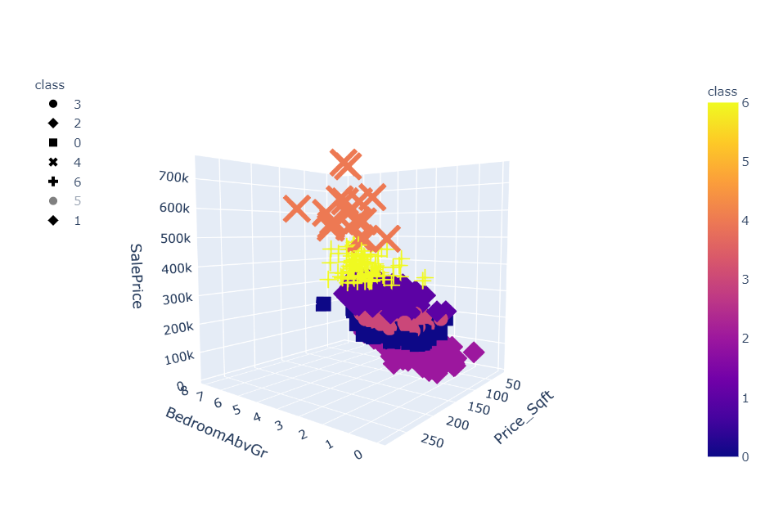
Ames Housing Data: cluster Profile
Cluster # 4 Profile:
Most Expensive Homes
4 Bedrooms
$200 - $300 per SqFt.

Slide 22
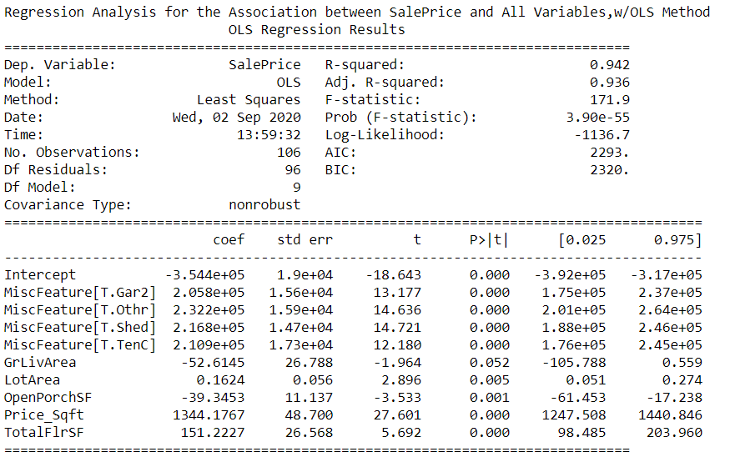
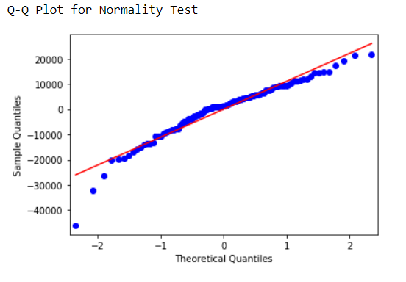
Regression model to predict: sales price
3 Outliers are Present

Slide 23
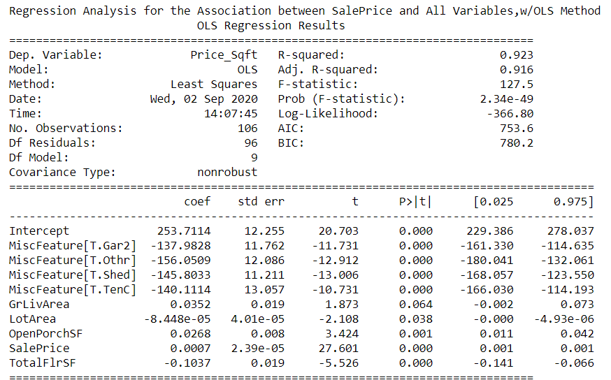
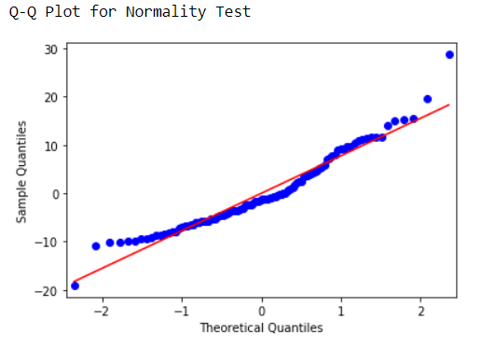
Regression model to predict: price_SqFoot

Slide 24
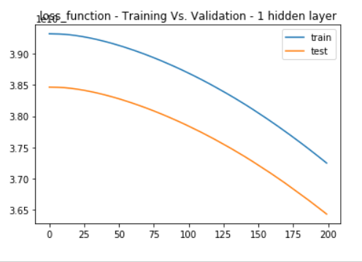
Deep learning model to predict sales price
val_mse: 12889930752
val_mse: 12889930752
Model MSE: 12889930752

Slide 25
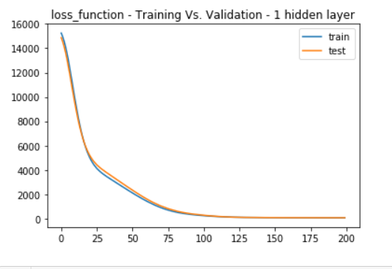
Deep learning model to predict: price_SqFoot
Model MSE: 66.25

Slide 26
Comparing models / model selection
Notes:
Select model with the lowest MSE.

Slide 27




PM: Process OVERVIEW
Lease Agreement
5
Transfer of NFT
3
1
Property Listed
6
Available for Rental
Security Deposit
4
Auction
2

Slide 28

DEMONSTRATIONs
Notes:
Real Estate Tokenization

Slide 29



NEXT STEPS
Real-time Property Listing
To incorporate API for having the list of property available for Sale
Investment of Security Deposit
Include Option to invest the security deposit to ETFs, Mutual Funds.
Payment Features
Security Deposit to be adjusted for property damages, un-paid rents.
Credit Scoring
Credit check facility for Investors (Incase of Mortgage) and prospective tenants
Contract Duration
Flexible Contract Duration for Rentals

Slide 30
KEY CHALLENGES
Solidity
Automatic Activation of Contracts
Termination
Frontend Development
Difficult to modify what has been already registered
Everything about it
01
02
03
04
05
06
Connecting Contracts
Liability
Linking the Auction Contract with the Rental Contract
ERC X
Difficult to identify the person liable for damages
To understand the flow of new ERC X for Rental & Mortgage transactions

